Slide 2
ACSeq is…
Pandemic Scale DNA Sequencing
As cheap as qPCR, with increased accuracy and with richer data

Slide 3
ACSeq Team
Seed/Pre-seed stage
Solo founder (Nava Whiteford):
Deep background in DNA sequencing technology.
Early employee (~25) at Oxford Nanopore.
Worked on early Illumina instruments at Sanger institute.
CTO of Solid State Nanopore DNA Sequencing Startup (Quantum Biosystems)
Acting COO of XGenomes (YC). Work with Kern Systems (YC) and Demonpore (YC)
Prior relationships with Omniome, DNAe and other sequencing companies.
PhD in Chemical Biology/Bioinf (sequencing by hybridization approach)

Slide 4
COVID19 Diagnostics and Sequencing

Slide 5
COVID19 Timeline
5th Jan 2020
Sample Sequenced
11th Jan 2020
Seq. Released
17th March 2020
“no ability to test”
30th April 2020
Phase 1 Vaccine Trials
12th Sept 2020
~100M Tests in US
17th Nov 2019
First Case
3rd Jan 2020
Sample Received
17th Jan 2020
(Berlin)
29th March 2020
~1M Tests in US
December 11, 2020
Vaccine Approved
2 Months from first case to sequence.
~5 Months from first case to 1M Tests
~10 Months for 100M Tests
https://www.theguardian.com/world/2020/mar/13/first-covid-19-case-happened-in-november-china-government-records-show-report
https://time.com/5882918/zhang-yongzhen-interview-china-coronavirus-genome/
https://www.statnews.com/2020/03/17/a-fiasco-in-the-making-as-the-coronavirus-pandemic-takes-hold-we-are-making-decisions-without-reliable-data/
https://ourworldindata.org/grapher/full-list-total-tests-for-covid-19?time=2020-02-20..2020-04-01

Slide 6
Sequencing and COVID19
Critically important for variant tracking:
“As COVID-19 cases surge again in the United States, coronavirus variants are on the rise. But researchers fear that the country is ramping up [sequencing based] surveillance of the coronavirus SARS-CoV-2 too slowly, allowing these variants — which evidence shows1,2 could make vaccines less effective — to spread undetected in one of the countries hit hardest by the disease.” Nature News, 07 APRIL 2021
https://www.nature.com/articles/d41586-021-00908-0

Slide 7
Sequencing and COVID19
Sequencing based diagnostics has been tried…

Slide 8
Sequencing and COVID19
…and failed to gain traction

Slide 9
Sequencing and COVID19
Because qPCR is $1:
And sequencing is $100s:
http://blog.biosearchtech.com/how-much-is-your-qpcr-assay-really-costing-you
https://ccb.jhu.edu/cbcc/pricing.shtml
“The cost of all steps, excluding labor, was estimated to be 106 USD per sample.”
Dimitrov KM er. al. (2017) A robust and cost-effective approach to sequence and analyze complete genomes of small RNA viruses. Virol J 14(1):72.

Slide 10
Sequencing and COVID19
But qPCR has problems that sequencing can overcome…
Single Mismatches in qPCR assays can “completely abolish PCR amplification”
https://www.ncbi.nlm.nih.gov/pmc/articles/PMC2797725/
https://41j.com/blog/2020/06/are-there-mutations-in-sars-cov-2-cdc-qpcr-primer-sites/
https://www.forbes.com/sites/joshuacohen/2021/03/17/latest-covid-19-variant-discovered-in-france-isnt-detected-by-standard-pcr-tests/?sh=21b42f877e18

Slide 11
We’re not ready for the next pandemic…
and without new tools, it’s still true….

Slide 13
ACSeq is… for pandemic response
New Variant/Pathogen discovery
Global monitoring network
Sample, RNA -> cDNA (RT)
Optionally deplete human RNA
QIAseq FX Single-cell RNA-seq library kit (Qiagen) coupled with human rRNA depletion
https://www.biorxiv.org/content/10.1101/2020.11.10.375022v1.full
User facing report

Slide 14
COVID19 Timeline
5th Jan 2020
Sample Sequenced
11th Jan 2020
Seq. Released
17th March 2020
“no ability to test”
30th April 2020
Phase 1 Vaccine Trials
12th Sept 2020
~100M Tests in US
17th Nov 2019
First Case
3rd Jan 2020
Sample Received
17th Jan 2020
(Berlin)
29th March 2020
~1M Tests in US
December 11, 2020
Vaccine Approved
2 Months from first case to sequence.
~5 Months from first case to 1M Tests
~10 Months for 100M Tests
https://www.theguardian.com/world/2020/mar/13/first-covid-19-case-happened-in-november-china-government-records-show-report
https://time.com/5882918/zhang-yongzhen-interview-china-coronavirus-genome/
https://www.statnews.com/2020/03/17/a-fiasco-in-the-making-as-the-coronavirus-pandemic-takes-hold-we-are-making-decisions-without-reliable-data/
https://ourworldindata.org/grapher/full-list-total-tests-for-covid-19?time=2020-02-20..2020-04-01

Slide 15
COVID22 Timeline (ACSeq)
17th Dec 2022
>10 More infections detected
20th Nov 2022
Abnormal RNA Detected
Draft Sequence available
18th March 2023
Vaccine Developed
17th Sept 2023
Projected Vaccine Trial Completion
17th Nov 2022
First Case
18th Jan 2023
Number of cases falls to near zero.
Does not leave host country
18th Dec 2022
Travel Restrictions on Infected
Vaccine development starts
Draft Sequence available 3 days after infection
Kits already deployed. No lead time to scale up.

Slide 16
ACSeq is… for pandemic response
Initial Target Market: Pandemic Response Labs/Sequencing Centers
…leading to a cheap point-of-care or at home test (<$1000 device, $10 run).

Slide 17
ACSeq is… cheap sequencing
Single molecule Optical Sequencing-by-synthesis (has been done before) but…
Our focus is on cheap instrument and run cost
No reversible terminators, higher error rate, short reads. Much much cheaper.

Slide 18
ACSeq is… cheap sequencing
Consumables are:
Simple glass flowcell (current cover glass $0.07)
Polymerases, labelled nucleotides (comparable to qPCR)
Instrument cost:
Consumer grade camera (<<$300)
Cheap laser diodes ($20)
Custom fluidics ($50)

Slide 19
ACSeq… Prototype

Slide 20
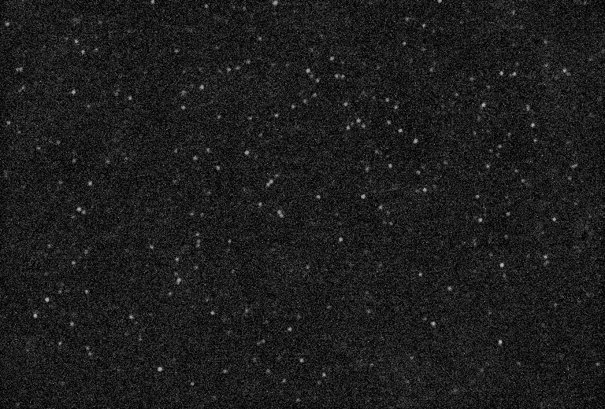
ACSeq… Prototype

Slide 21
ACSeq… next steps
Camera - IMX178 - $300
Filter - $80
Focusing stepper/DC -$20
Objective 60/100x -$20
50x150mm
Electro-fluidic system -$20
Prism
$20
Laser - $20
A
T
G
C
Prototype Single Unit Costs, Total: $500+Enclosure

Slide 22
ACSeq next steps
Target specs:
~20bp reads
<5% error rate
100,000 to 1M reads
Reads and error rates and conservative/based on existing platforms. 15bp is sufficient for alignment to viral genomes. Read count based on single imaging region.

Slide 23
ACSeq next steps
Plan $100K
Build custom $500 optical prototype.
Company Formation (US, UK and Japan)
One or two more optical platforms (GA2 based) for experimentation
Begin work on strands, image incorporation/bleaching on strand.
Hire consultants that can move to full time (or co-founder level)
Progress provisionals through to full applications
Manage burn over 6 months
Plan $500K (as 100K+)
Proof-of-concept on full sequencing.
Proof-of-concept on fluidic approaches.
Develop additional IP covering fluidic/error correction approaches.
Additional IP around nucleotides, imaging approaches.
Manage burn over 1 year.
Plan $5M (as 500K+)
Hiring: IP lead, Biochemistry lead, Hardware lead, Nucleotide development?
Company Formation (US, UK or Japan)
Manage burn over 1 year.

