Slide 2
ACSeq is…
Pandemic Scale DNA Sequencing
As cheap as qPCR, with increased accuracy and with richer data

Slide 3
ACSeq Team
Seed/Pre-seed stage
Solo founder (Nava Whiteford):
Deep background in DNA sequencing technology.
Early employee (~25) at Oxford Nanopore.
Worked on early Illumina instruments at Sanger institute.
CTO of Solid State Nanopore DNA Sequencing Startup (Quantum Biosystems)
Acting COO of XGenomes (YC). Work with Kern Systems (YC) and Demonpore (YC)
Prior relationships with Omniome, DNAe and other sequencing companies.
PhD in Chemical Biology/Bioinf (sequencing by hybridization approach)

Slide 4
COVID19 Diagnostics and Sequencing

Slide 5
COVID19 Timeline
5th Jan 2020
Sample Sequenced
11th Jan 2020
Seq. Released
17th March 2020
“no ability to test”
30th April 2020
Phase 1 Vaccine Trials
12th Sept 2020
~100M Tests in US
17th Nov 2019
First Case
3rd Jan 2020
Sample Received
17th Jan 2020
(Berlin)
29th March 2020
~1M Tests in US
December 11, 2020
Vaccine Approved
2 Months from first case to sequence.
~5 Months from first case to 1M Tests
~10 Months for 100M Tests
https://www.theguardian.com/world/2020/mar/13/first-covid-19-case-happened-in-november-china-government-records-show-report
https://time.com/5882918/zhang-yongzhen-interview-china-coronavirus-genome/
https://www.statnews.com/2020/03/17/a-fiasco-in-the-making-as-the-coronavirus-pandemic-takes-hold-we-are-making-decisions-without-reliable-data/
https://ourworldindata.org/grapher/full-list-total-tests-for-covid-19?time=2020-02-20..2020-04-01

Slide 6
Sequencing and COVID19
Critically important for variant tracking:
“As COVID-19 cases surge again in the United States, coronavirus variants are on the rise. But researchers fear that the country is ramping up [sequencing based] surveillance of the coronavirus SARS-CoV-2 too slowly, allowing these variants — which evidence shows1,2 could make vaccines less effective — to spread undetected in one of the countries hit hardest by the disease.” Nature News, 07 APRIL 2021
https://www.nature.com/articles/d41586-021-00908-0

Slide 7
Sequencing and COVID19
Sequencing based diagnostics has been tried…

Slide 8
Sequencing and COVID19
…and failed to gain traction

Slide 9
Sequencing and COVID19
Because qPCR is $1:
http://blog.biosearchtech.com/how-much-is-your-qpcr-assay-really-costing-you

Slide 10
Sequencing and COVID19
And sequencing is $100s:
https://ccb.jhu.edu/cbcc/pricing.shtml
“The cost of all steps, excluding labor, was estimated to be 106 USD per sample.”
Dimitrov KM er. al. (2017) A robust and cost-effective approach to sequence and analyze complete genomes of small RNA viruses. Virol J 14(1):72.

Slide 11
Sequencing and COVID19
Illumina sequencing can get 10x cheaper:
“11M in costs gave 99M in revenue. 88% gross margin.”
https://41j.com/blog/2018/11/illumina-consumables-are-90-profit/
But unlikely 100x cheaper. And Illumina are focused on “cost-per-base” not “cost-per-run” ($600 to $30000).

Slide 12
Sequencing and COVID19
But qPCR has problems that sequencing can overcome…
Single Mismatches in qPCR assays can “completely abolish PCR amplification”
https://www.ncbi.nlm.nih.gov/pmc/articles/PMC2797725/
https://41j.com/blog/2020/06/are-there-mutations-in-sars-cov-2-cdc-qpcr-primer-sites/
https://www.forbes.com/sites/joshuacohen/2021/03/17/latest-covid-19-variant-discovered-in-france-isnt-detected-by-standard-pcr-tests/?sh=21b42f877e18

Slide 13
We’re not ready for the next pandemic…
and without new tools, it’s still true….

Slide 15
ACSeq is… for pandemic response
New Variant/Pathogen discovery
Global monitoring network
Sample, RNA -> cDNA (RT)
Optionally deplete human RNA
QIAseq FX Single-cell RNA-seq library kit (Qiagen) coupled with human rRNA depletion
https://www.biorxiv.org/content/10.1101/2020.11.10.375022v1.full
User facing report

Slide 16
COVID19 Timeline
5th Jan 2020
Sample Sequenced
11th Jan 2020
Seq. Released
17th March 2020
“no ability to test”
30th April 2020
Phase 1 Vaccine Trials
12th Sept 2020
~100M Tests in US
17th Nov 2019
First Case
3rd Jan 2020
Sample Received
17th Jan 2020
(Berlin)
29th March 2020
~1M Tests in US
December 11, 2020
Vaccine Approved
2 Months from first case to sequence.
~5 Months from first case to 1M Tests
~10 Months for 100M Tests
https://www.theguardian.com/world/2020/mar/13/first-covid-19-case-happened-in-november-china-government-records-show-report
https://time.com/5882918/zhang-yongzhen-interview-china-coronavirus-genome/
https://www.statnews.com/2020/03/17/a-fiasco-in-the-making-as-the-coronavirus-pandemic-takes-hold-we-are-making-decisions-without-reliable-data/
https://ourworldindata.org/grapher/full-list-total-tests-for-covid-19?time=2020-02-20..2020-04-01

Slide 17
COVID22 Timeline (ACSeq)
17th Dec 2022
>10 More infections detected
20th Nov 2022
Abnormal RNA Detected
Draft Sequence available
18th March 2023
Vaccine Developed
17th Sept 2023
Projected Vaccine Trial Completion
17th Nov 2022
First Case
18th Jan 2023
Number of cases falls to near zero.
Does not leave host country
18th Dec 2022
Travel Restrictions on Infected
Vaccine development starts
Draft Sequence available 3 days after infection
Kits already deployed. No lead time to scale up.

Slide 18
ACSeq is… for pandemic response
Initial Target Market: Pandemic Response Labs/Sequencing Centers
…leading to a cheap point-of-care or at home test (<$1000 device, $10 run).

Slide 19
ACSeq is… cheap sequencing
Single molecule Optical Sequencing-by-synthesis (has been done before) but…
Our focus is on cheap instrument and run cost
No reversible terminators, higher error rate, short reads. Much much cheaper.

Slide 20
ACSeq is… cheap sequencing
Consumables are:
Simple glass flowcell (current cover glass $0.07)
Polymerases, labelled nucleotides (comparible to qPCR)
Instrument cost:
Consumer grade camera (<<$300)
Cheap laser diodes ($20)
Custom fluidics ($50)

Slide 21
ACSeq… Prototype

Slide 22
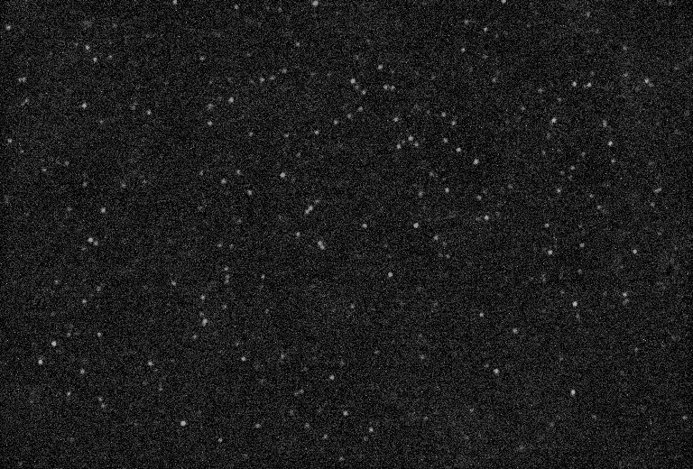
ACSeq… Prototype

Slide 23
ACSeq… next steps
Camera - IMX178 - $300
Filter - $80
Focusing stepper/DC -$20
Objective 60/100x -$20
50x150mm
Electro-fluidic system -$20
Prism
$20
Laser - $20
Prototype Single Unit Costs, Total: $500+Enclosure

Slide 24
ACSeq… next steps
A
T
G
C

Slide 25
ACSeq next steps
Target specs:
~20bp reads
<5% error rate
100,000 to 1M reads
Reads and error rates and conservative/based on existing platforms. Sufficient for alignment to viral genomes. Read count based on single imaging region.

Slide 26
ACSeq next steps
Plan $100K
Build custom $500 optical prototype.
Company Formation (US, UK and Japan)
One or two more optical platforms (GA2 based) for experimentation
Begin work on strands, image incorporation/bleaching on strand.
Hire consultants that can move to full time (or co-founder level)
Progress provisionals through to full applications
Manage burn over 6 months
Plan $500K (as 100K+)
Proof-of-concept on full sequencing.
Proof-of-concept on fluidic approaches.
Develop additional IP covering fluidic/error correction approaches.
Additional IP around nucleotides, imaging approaches.
Manage burn over 1 year.
Plan $5M (as 500K+)
Hiring: IP lead, Biochemistry lead, Hardware lead, Nucleotide development?
Company Formation (US, UK or Japan)
Manage burn over 1 year.

Slide 27
Thoughts and Prior Writings
Sequencing for $1: https://41j.com/blog/2016/03/road-to-the-1-genome/
Sequencing is universal sensing: http://41j.com/blog/2016/03/are-you-sure-this-isnt-horse-dna-sequencing-is-universal-sensing/
List of current approaches: https://41j.com/blog/2018/07/dna-sequencing-companies-july-2018/
COVID19 mutations in qPCR sites: https://41j.com/blog/2020/06/are-there-mutations-in-sars-cov-2-cdc-qpcr-primer-sites/
Illumina 10x profit on consumables: https://41j.com/blog/2018/11/illumina-consumables-are-90-profit/
Why Japan: https://41j.com/blog/2021/04/dna-sequencing-and-japan/
Optical System Notes:
https://41j.com/blog/2021/04/single-dye-experiments-on-a-genome-analyzer/
https://41j.com/blog/2021/04/photobeaching-on-the-genome-analyzer-using-a-imx178/
Image analysis platform for Illumina sequencers: https://pubmed.ncbi.nlm.nih.gov/19549630/

Slide 28
Appendix - Read Length Requirements

Slide 29
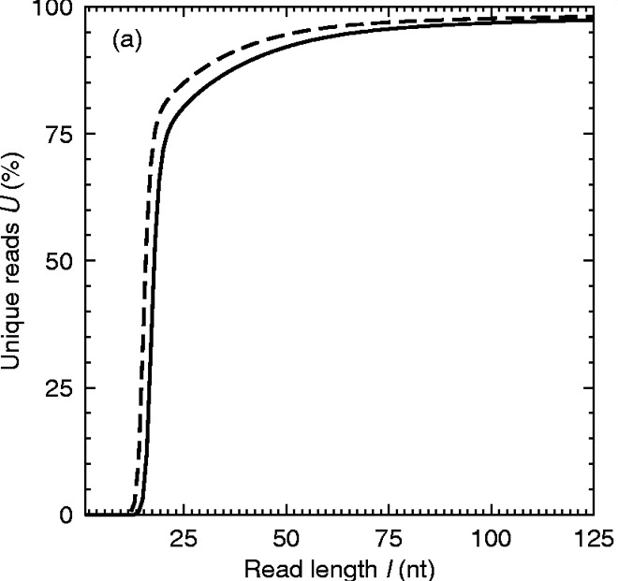
ACSeq - Read Length Requirements
94%
https://academic.oup.com/nar/article/33/19/e171/1308836
Against human + NCBI Viruses
https://bmcgenomics.biomedcentral.com/articles/10.1186/1471-2164-13-177/figures/2

Slide 30
ACSeq - Read Length Requirements (5% error)
78%
Against human + NCBI Viruses
https://bmcgenomics.biomedcentral.com/articles/10.1186/1471-2164-13-177/figures/2

Slide 31
ACSeq - False Negative Rate (5% error)
At 0.01%, 0.3*10-5
We expect > x100 this (>1%)
qPCR: >1%
Against human + NCBI Viruses. 100,000 reads
https://www.nejm.org/doi/full/10.1056/NEJMp2015897
https://virologyj.biomedcentral.com/articles/10.1186/s12985-021-01489-0

Slide 32
ACSeq - Single Read False Positive Rate (5% error)
qPCR: 1.1%
Human + NCBI Virus reads (5% error rate), aligned against Human+NCBI+SARS-CoV-2
https://www.medrxiv.org/content/10.1101/2021.04.06.21255029v2

Slide 33
Appendix - Illumina

Slide 34
Illumina Analysis
NovaSeq:
Lowest cost per base, highest cost per run.
Flowcell nanofabrication likely sets on flowcell floor.
iSeq 100:
Lowest instrument cost ($20000)
Low(ish) run cost ~$600
Incorporation of CMOS sensor likely sets on flowcell floor.

Slide 35
Illumina Analysis
Miseq:
Relatively cheap flowcell (Glass, fused silica?)
Reagent cartridge
Likely Illumina’s lowest run cost (of goods) instrument.

Slide 36
Illumina Analysis - Miseq (instrument)
https://fccid.io/ZWF-MISEQ/Block-Diagram/MiSeq-Block-Diagram-1536935

Slide 37
Illumina Analysis - Miseq (instrument)
MiSeq
Cameras 2x Sony IMX038: Estimate $1800
Z-Stage (PI): $1000
Y-Stage: $100?
HDD: $50
Compute: $200
LEDs/photodiodes: $50
TECs: $50
Nikon x20 Objective: $400
Fluidics System: $300
Total: $3900
ACSeq
Cameras 1x Sony IMX178: Estimate $100 ($300)
Z-Stage: $20
Y-Stage
HDD
Compute: $10
Laser: $20
TECs: $50
Cheap Shenzhen Objective: $20
Fluidics System
Total: $220

Slide 38
Illumina Analysis - MiSeq Flowcell
Glass substrate.
Covalently bound oligonucleotides for capture.
Likely, cheap (<<10USD).
ACSeq costs similar or less.

Slide 39
Illumina Analysis - Reagents

Slide 40
Illumina Analysis - Reagents
1 | IMT | Incorporation Mix
2 | USM | Scan Mix
3 | CMS | Cleavage Mix
4 | AMS1 | Amplification Mix, Read 1
5 | AMS2 | Amplification Mix, Read 2
6 | LPM | Linearization Premix
7 | LDR | Formamide
8 | LMX1 | Linearization Mix, Read 1
9 | LMX2 | Linearization Mix. Read 2
10 | RMF | Resynthesis Mix
11 | HP10 | Primer Mix, Read 1
12 | HP12 | Index Primer Mix
13 | HP11 | Primer Mix, Read 2
14 | PW1 | Water

Slide 41
Illumina Analysis - Reagents (no read 2)
1 | IMT | Incorporation Mix
2 | USM | Scan Mix
3 | CMS | Cleavage Mix
4 | AMS1 | Amplification Mix, Read 1
5 | AMS2 | Amplification Mix, Read 2
6 | LPM | Linearization Premix
7 | LDR | Formamide
8 | LMX1 | Linearization Mix, Read 1
9 | LMX2 | Linearization Mix. Read 2
10 | RMF | Resynthesis Mix
11 | HP10 | Primer Mix, Read 1
12 | HP12 | Index Primer Mix
13 | HP11 | Primer Mix, Read 2
14 | PW1 | Water

Slide 42
Illumina Analysis - Reagents (no index)
1 | IMT | Incorporation Mix
2 | USM | Scan Mix
3 | CMS | Cleavage Mix
4 | AMS1 | Amplification Mix, Read 1
5 | AMS2 | Amplification Mix, Read 2
6 | LPM | Linearization Premix
7 | LDR | Formamide
8 | LMX1 | Linearization Mix, Read 1
9 | LMX2 | Linearization Mix. Read 2
10 | RMF | Resynthesis Mix
11 | HP10 | Primer Mix, Read 1
12 | HP12 | Index Primer Mix
13 | HP11 | Primer Mix, Read 2
14 | PW1 | Water

Slide 43
Illumina Analysis - Reagents (single molecule)
1 | IMT | Incorporation Mix
2 | USM | Scan Mix
3 | CMS | Cleavage Mix
4 | AMS1 | Amplification Mix, Read 1
5 | AMS2 | Amplification Mix, Read 2
6 | LPM | Linearization Premix
7 | LDR | Formamide
8 | LMX1 | Linearization Mix, Read 1
9 | LMX2 | Linearization Mix. Read 2
10 | RMF | Resynthesis Mix
11 | HP10 | Primer Mix, Read 1
12 | HP12 | Index Primer Mix
13 | HP11 | Primer Mix, Read 2
14 | PW1 | Water

Slide 44
Illumina Analysis - Reagents (bleach/digest)
1 | IMT | Incorporation Mix
2 | USM | Scan Mix
3 | CMS | Cleavage Mix
4 | AMS1 | Amplification Mix, Read 1
5 | AMS2 | Amplification Mix, Read 2
6 | LPM | Linearization Premix
7 | LDR | Formamide
8 | LMX1 | Linearization Mix, Read 1
9 | LMX2 | Linearization Mix. Read 2
10 | RMF | Resynthesis Mix
11 | HP10 | Primer Mix, Read 1
12 | HP12 | Index Primer Mix
13 | HP11 | Primer Mix, Read 2
14 | PW1 | Water

Slide 45
Illumina Analysis - Reagents (1 channel)
A
1 | IMT | Incorporation Mix
2 | USM | Scan Mix
3 | CMS | Cleavage Mix
4 | AMS1 | Amplification Mix, Read 1
5 | AMS2 | Amplification Mix, Read 2
6 | LPM | Linearization Premix
7 | LDR | Formamide
8 | LMX1 | Linearization Mix, Read 1
9 | LMX2 | Linearization Mix. Read 2
10 | RMF | Resynthesis Mix
11 | HP10 | Primer Mix, Read 1
12 | HP12 | Index Primer Mix
13 | HP11 | Primer Mix, Read 2
14 | PW1 | Water
T
G
C

Slide 46
Illumina Analysis - Reagents (TEC based/off instrument)
A
1 | IMT | Incorporation Mix
2 | USM | Scan Mix
3 | CMS | Cleavage Mix
4 | AMS1 | Amplification Mix, Read 1
5 | AMS2 | Amplification Mix, Read 2
6 | LPM | Linearization Premix
7 | LDR | Formamide
8 | LMX1 | Linearization Mix, Read 1
9 | LMX2 | Linearization Mix. Read 2
10 | RMF | Resynthesis Mix
11 | HP10 | Primer Mix, Read 1
12 | HP12 | Index Primer Mix
13 | HP11 | Primer Mix, Read 2
14 | PW1 | Water
T
For ACSeq: 120nM, 120uL * 20
G
~$1 in quantity 1
$0.0037 in quantity.
C
apyrase

Slide 47
Appendix - Fluidics

Slide 48
ACSeq - Surface attachment
+ Random priming
https://www.sciencedirect.com/science/article/abs/pii/S0003269701950882?via%3Dihub

Slide 49
A
T
G
C
apyrase
Apyrase: https://science.sciencemag.org/content/281/5375/363 (1998)

Slide 50
Appendix - Nucleotides

Slide 51
ACSeq, no terminators, no cleavable label
https://www.pnas.org/content/pnas/100/7/3960.full.pdf
https://www.ncbi.nlm.nih.gov/pmc/articles/PMC1783441/
https://www.tandfonline.com/doi/abs/10.1080/07391102.1989.10507773
https://www.sciencedirect.com/science/article/abs/pii/S016816560000417X
https://www.sciencedirect.com/science/article/abs/pii/S016816560000420X

Slide 52
ACSeq, nucleotide costs
https://www.freepatentsonline.com/8367377.pdf
100nM, 120uL = $0.00003 per flow
$0.0037 for 30 cycles (30x4, 60+ bases)

Slide 53
Appendix - Extraction

Slide 54
Method | Cost/Sample | 1000
MagBeads | $1.70 | $0.6 to $1.5
Spin Column Kit | $0.20
Spin Column Only | $0.05
QIAamp Viral RNA Kit |  | $4.82
Quick-DNA Viral 96 |  | $3.10
Roche MagNA 96 (LabCorp) |  | $4.42

Slide 55
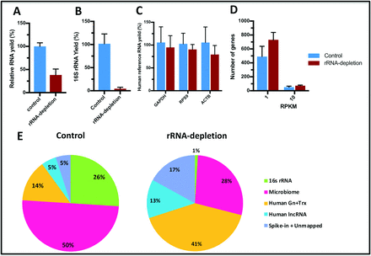
QIAseq FX Single-cell RNA-seq library kit (Qiagen) coupled with human rRNA depletion
https://www.biorxiv.org/content/10.1101/2020.11.10.375022v1.full
Total RNA: 50Kb to 500Kb from target genome (SARS-CoV-2 30Kb)
Deplete rRNA: 100Kb to 1Mb from target genome (SARS-CoV-2 30Kb)

Slide 56
Appendix - Multiplexing

Slide 57
Illumina Multiplexing
~25% variation in read count
Nearly 50% variation in read count
https://international.neb.com/products/e6446-nebnext-multiplex-oligos-for-illumina-96-unique-dual-index-primer-pairs-set-4#Product%20Information

Slide 58
Illumina Multiplexing >$15
NextSeq, medium output run.
Multiplexing to 384 samples here gives a base sequencing cost of $6.5
(this is before labor and library prep costs which push this to ~$15).
Vendors then sell this for >$100
https://www.illumina.com/science/technology/next-generation-sequencing/beginners/ngs-cost.html
https://www.research.colostate.edu/genomics/pricing/

